Slide 1
R&D Committee Workshop Series: Review and Approval of Non-Veterans in VA Research
Dial in (Main): (415) 655-0060
Dial in (Alt): (914) 339-0032
Attendee Access Code: 260-647-212
Slides in “Handout” Tab
Molly Klote, MD
Director
ORPP&E
October 22, 2020

Slide 2
Objectives
Review the definition of VA research and the statutory authority of the R&DC
Review the R&D Committee’s responsibility for reviewing requests to include non-Veterans in VA research
Discuss when non-Veterans may be recruited for VA Research
Discuss responsibilities for cost of subject injury
Provide considerations for the R&D Committee when reviewing requests to include non-Veterans in VA research

Slide 3
VA Research
VA Research is research conducted by VA investigators (serving on compensated, WOC, or IPA appointments) while on VA time or on VA property. The research may be funded by VA, by other sponsors, or be unfunded.
VA Research must be approved by the R&D Committee before it can be initiated.
VHA Directive 1200.01 paragraph 3f

Slide 4
VA Research (continued)
VA is required to provide necessary medical treatment for a subject injured as a result of participating in VA approved research, irrespective of Veteran status (VHA Directive 1200.05 paragraph 24).
VA medical facilities shall provide necessary medical treatment to a research subject injured as a result of participation in a research project approved by a VA Research and Development Committee and conducted under the supervision of one or more VA employees (38 CFR §17.85).

Slide 5
Reviews by the R&D Committee and its subcommittees must ensure the following:
Relevance of the Research to VA’s Mission and the Care of Veterans
Availability of Qualified Research Team Members, including Investigators
R&D Committee Review of Research
Security of Research Laboratories
Protection of Human Subjects and Implementation of Adequate Safety Measures for Research Subjects & Personnel and
Welfare of and Appropriate Use and Care of Animals
in Research
Availability of Required Resources, Investigator’s Time, and Appropriate Location to Conduct Research
Security of VA Data,
VA Sensitive Information, and Storage of Data and Specimens
Scientific Merit of the Research Proposal
VHA Directive 1200.01 Paragraph 12

Slide 6
VA Mission
To fulfill President Lincoln's promise "To care for him who shall have borne the battle, and for his widow, and his orphan" by serving and honoring the men and women who are America’s Veterans.
Veterans Healthcare Administration
is the largest integrated health care network in the United States, with 1,255 health care facilities serving 9 million enrolled Veterans each year.
Veterans Benefits Administration
helps servicemembers transition out of military service, and assists with education, home loans, life insurance and much more.
National Cemeteries Administration
provides dignified burial services for Veterans and eligible family members by maintaining 142 cemeteries as national shrines and providing lasting tributes that commemorate their service and sacrifice to our nation.
is to improve the Nation’s preparedness for response to war, terrorism, national emergencies, and natural disasters by developing plans and taking actions to ensure continued service to veterans, as well as to support national, state, and local emergency management, public health, safety and homeland security efforts.
VA’s Fourth Mission

Slide 7
Why is the R&D Committee required to review and approve recruitment of non-Veterans in VA research instead of an Institutional Review Board (IRB)?
“…The R&D Committee is responsible for ensuring that all research in which the facility is engaged is consistent with the VA mission. The evaluation of whether the inclusion of non-Veterans in a proposed VA research activity is consistent with meeting the VA mission cannot be delegated to an Institutional Review Board (IRB) because the evaluation is not a human subjects protections issue; it is an institutional evaluation. In addition, VA conducts many exempt human subjects research activities that could involve non-Veterans.”
VHA Directive 1200.01, Research and Development Committee: FAQ #3

Slide 8
Veteran Definition
VA research focuses on health issues that affect Veterans.
A Veteran as defined in 38 U.S. Code §101(2) “. . . means a person who served in the active military, naval, or air service, and who was discharged or released therefrom under conditions other than dishonorable.”
Examples of Non-Veterans
People who do not otherwise meet the definition of a Veteran, to include:
Caregivers
Providers
Employees
Students

Slide 9
Eligible versus not eligible
Veteran who is eligible for VHA care
>29% disability by VBA – eligible
Veteran who is NOT eligible for VHA Care
<30% disability by VBA – not eligible
Consider eligibility of the Veteran! Eligibility determination can be a 3-6 month-long process.

Slide 10
Mental Health Care Exception
Get free mental health care for a year after separation—no matter your discharge status, service history, or eligibility for VA health care.
https://www.va.gov/health-care/health-needs-conditions/mental-health/
This does not make them a “Veteran” for the purpose of research

Slide 11
Is specific R&DC approval required?
VHA Directive 1200.01, Paragraph 13.a. describes the specific responsibilities of the VA Investigator and the R&D Committee when non-Veterans are proposed to be included in VA research.
“. . . The investigator must justify including non-Veterans, and the R&D Committee must review the justification and provide specific approval for recruitment of non-Veterans.”

Slide 12
Can the R&D Committee Use the Designated Review Process to Approve the Inclusion of Non- Veterans?
“…If the VA research activity can be approved by a R&D Committee through a designated review process, such as exempt human subject research protocols and protocols approved by expedited review by the IRB, the review and approval for inclusion of non-Veterans in a VA research protocol can be done by designated review.”
VHA Directive 1200.01, Research and Development Committee: FAQ #4

Slide 13
Under what circumstances can Non-Veterans be recruited for VA research?
Option A
Non-Veterans may be entered into a VA-approved research study that involves VA outpatient or VA hospital treatment, but only when there are insufficient Veteran patients suitable for the study (see 38 CFR 17.45, 17.92).
Option B
Non-Veterans may be recruited for studies that will generally benefit Veterans and their well-being but would not include Veterans as subjects.
Examples include surveys of VA providers, studies involving Veterans’ family members, or studies including active duty military personnel.
Non-Veterans may not be entered into VA studies simply because a non-Veteran population is easily accessible to the investigator.

Slide 14
Non-Veterans that Receive Treatment at the VA under VA’s Fourth Mission
VA’s Fourth Mission provides treatment for non-Veterans under specific circumstances.
Can Non-Veterans receiving treatment under VA’s Fourth Mission be enrolled in VA Research?
Yes. Non-Veterans receiving treatment under VA’s Fourth Mission can be enrolled in VA research when the VA facility is a participating site.
Is R&D Committee approval of recruitment of non-Veterans required?
Yes.

Slide 15
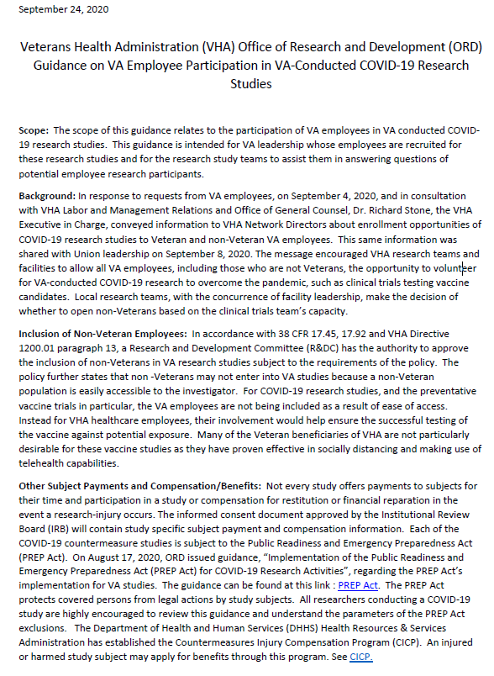
VA Employees Participating in VA-Conducted COVID-19 Research Studies
VHA Research teams and facilities are encouraged to allow enrollment of VA employees, including those who are not Veterans, in VA-conducted COVID-19 research (message from Dr. Stone dated 09/04/2020).
Contractors are not considered VA employees and may not participate in these COVID-19 employee research efforts.
Local research teams, with concurrence of facility leadership, make the decision of whether to open the study to non-Veterans based on the clinical trials team’s capacity.
Inclusion of VA employees in these COVID-19 studies is not due to the population being easily accessible; employee participation in the research helps provide useful information and ensure successful testing of the agents being studied.
https://www.research.va.gov/resources/policies/guidance/Employee-Participation-COVID19-Research.pdf

Slide 16
VA Employees Participating in VA-Conducted COVID-19 Research Studies
Conditions of employment will not change for an employee who chooses to volunteer for a COVID-19 study.
Volunteering must be done during non-duty hours
Conditions of employment such as required vaccine schedules must be adhered to (e.g. flu vaccination).
Treatment for research related injuries must be provided to Employees participating in these studies.

Slide 17
Creating a Medical Record for a non-Veteran
Each VA Facility will have its own processes that must be followed to create a medical record in CPRS/CERNER for a non-Veteran.
Once approval from the R&D Committee for the inclusion of non-Veterans has been obtained, coordination with Central Registration is typically required to have a medical record created.
Some VA Facilities report that it only takes one day to have a new medical record created once a request has been received.

Slide 18
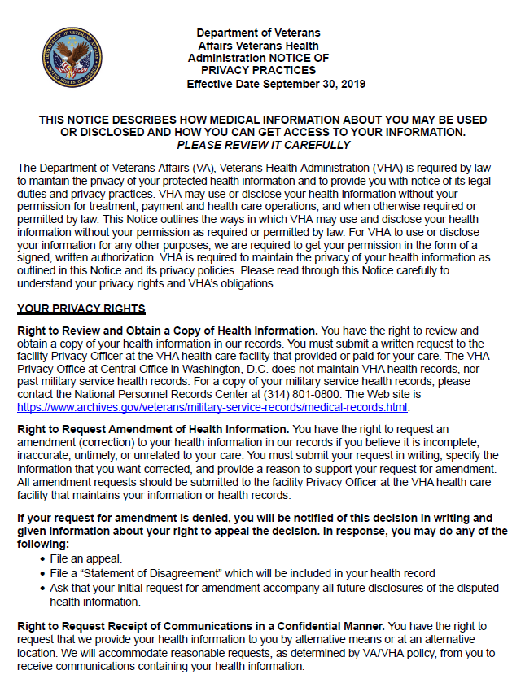
Providing Non-Veterans with a Notice of Privacy Practices and Receiving Acknowledgement
When must a Notice of Privacy Practice (NOPP) be provided to non-Veterans included in VA research?
At the first episode of care or appointment where care is provided.
A VA NOPP is not required if the research study does not include providing care to the non-Veteran.
VHA health care facilities must provide the Notice of Privacy Practices at the episode of care when the non-Veteran patient checks in for their treatment or care (with or without an appointment), attends their first research visit associated with an episode of care, is seen in Employee Health or when the non-Veteran patient is admitted to the VHA health care facility…(VHA Handbook 1605.04 paragraph 9).
Once a NOPP is provided, an acknowledgement (VA Form 10-0483) must be signed by the Non-Veteran.
http://vaww.vhaco.va.gov/privacy/Documents/Large_Print_NOPP.pdf

Slide 19
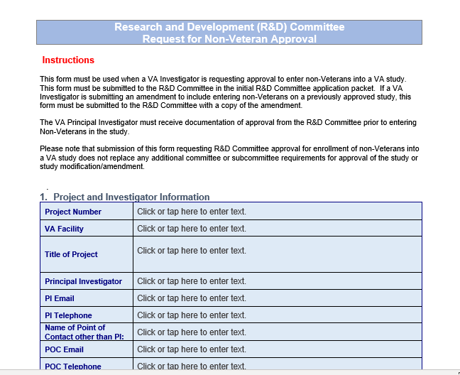
Requests for R&D Committee Approval of Recruitment of Non-Veterans: R&D Committee Non-Veteran Application

Slide 20
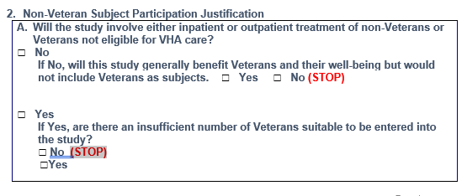
Requests for R&D Committee Approval of Recruitment of Non-Veterans: R&D Committee Non-Veteran Application

Slide 21
Requests for R&D Committee Approval of Recruitment of Non-Veterans: R&D Committee Non-Veteran Application

Slide 22
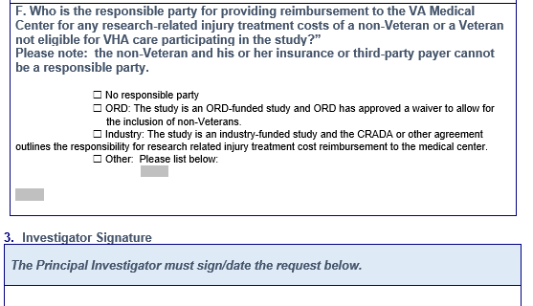
Requests for R&D Committee Approval of Recruitment of Non-Veterans: R&D Committee Non-Veteran Application

Slide 23
Let’s Talk Money - Who Pays for What When a Research-Related Injury Occurs?
VHA Medical Center Directors have a responsibility to care for or arrange care for any VA subject injured as a result of participating in a VA R&D Committee approved research study as required by 38 CFR 17.85.
A study sponsor can be made responsible for reimbursing the Medical Center for costs associated with a research-related injury if such terms are included in the contractual agreement with the study sponsor.

Slide 24
Payment of Research Related Injuries: Unfunded Studies and Studies where Sponsor does not Cover Research-Related Injuries
In cases where the Medical Facility is responsible for paying for the costs associated with research-related injuries, the following funds may be used to reimburse for study-related injuries:
ORD does not have funds set aside to reimburse medical facilities for costs incurred for research-related injuries
Except when ORD approves non-Veteran involvement in an ORD-funded study.
 | Eligible Veteran RRI | Non-Eligible Veteran RRI | Non-Veteran RRI
Medical Appropriations
Research Appropriations

Slide 25
Payment of Research-Related Injuries for Non-Veterans: Funded Studies
Industry-Funded Studies | Federally Funded Studies | ORD Funded-Studies
The contractual agreement with the study sponsor should cover reimbursement for research-related injuries of research subjects, to include non-Veterans. | The VA Medical Center is usually responsible for costs associated with research-related injuries for federally funded studies. | ORD is responsible for costs associated with research-related injuries for Non-Veterans when the VA Medical Center obtains approval from the ORD funding service for the enrollment of non-Veterans.
The Medical Center initially covers the cost of the injury and is subsequently reimbursed per the terms of the agreement. | NIH/DOD do not have a formal compensation policy for injuries resulting from extramural research. The award notice or agreement between the federal institution and the recipient institution should be reviewed to determine if reimbursement of research-related injuries is covered. | The PI must obtain approval from the funding service prior to submitting the request to recruit non-Veterans to the R&D Committee.
If the contractual agreement does not cover reimbursement of research-related injuries, the Medical Center is responsible for the costs. | For DOD funded or for studies involving service members, there may be an opportunity for a DOD medical center to care for the RRI.

Slide 26
Practical Considerations and Strategies for Navigating Approval of non-Veterans in VA Research: R&D Committee
What strategies can be used to ensure that the R&D Committee approves the recruitment of non-Veterans when a study is amended to include non-Veterans?
Include a statement in the original R&DC approval letter that if at some point in the study the PI needs to expand the study population to include non-Veterans, the PI must inform the R&DC.

Slide 27
Practical Considerations and Strategies for Navigating Approval of non-Veterans in VA Research: IRB
What is the IRB required to approve when a non-exempt human subjects research study is amended to include non-Veterans?
No specific additional policy requirements
The IRB must continue to ensure that any change in the research continues to meet ethical standards for protecting research subjects.
Materials submitted that affect inclusion of non-Veterans should be reviewed, for example:
Recruitment plan and materials
Changes in the informed consent form
Changes to study sample size

Slide 28
Practical Considerations and Strategies for Navigating Approval of non-Veterans in VA Research: IRB (continued)
Should an IRB-approved informed consent form for a study that will enroll non-Veterans include a statement that a non-Veterans’ insurance or the non-Veteran subject will be responsible for study costs or research-related injuries?
No. VHA Directive 1200.05 paragraph 17d(10) requires that a statement be provided to subjects that VA will provide treatment for research related injury in accordance with 38 CFR 17.85. This applies to all subjects enrolled in VA research.
VHA Directive 1200.05 paragraph 17e(10) requires, when appropriate, a statement be provided to research subjects that they or their insurance will not be charged for any costs related to the research.
If co-payments are required for medical care and services specifically related to a subject’s medical care provided by VA, this can and should be conveyed during the informed consent process.

Slide 29
Questions

Slide 30
Resources for Information about ORD Policy and Guidance on Human Subjects Research
ORD Searchable FAQs:
https://www.research.va.gov/resources/policies/faq-search.cfm
Contains approximately 200 published FAQs
Database will be expanded in the next month to include questions and answers contained in ORD guidance documents
ORD Policy and Guidance Webpage:
https://www.research.va.gov/resources/policies/human_research.cfm
Contains all ORD FAQs, Guidance Documents, and Memorandums pertaining to Human Subjects Research

Slide 31
Resources for Information about ORD Policy and Guidance on Human Subjects Research
ORPP&E Sample Templates
https://www.research.va.gov/programs/orppe/policy/draft/default.cfm
Contains over 60 sample templates, application forms, reviewer forms, flow charts pertaining to the review and oversight of research involving human subjects.
ORPP&E Toolkits
https://www.research.va.gov/programs/orppe/education/tools.cfm
Currently contains two toolkits on Exempt Research and R&D Committee Review
Lookout for a release of a new toolkit on Information Security Reviews in the near future.
ORD Regulatory Mailbox
When all else fails, email vhacoordregulatory@va.gov

Slide 32
Research and Development Committee Workshop Series
Proposed Training | Training Type | Tentative Date
Differentiating roles of the R&D Committee and the IRB | Traditional Webinar | 11/7/2019
R&D Committee Responsibility: Review and Approval of Research | Workshop | 12/11/2019
R&D Committee Operations: Convened Meeting vs. Designated Member Review (DMR) | Workshop | 12/19/2019
R&D Committee Responsibility: Part 1- Review and Approval of Exempt Research | Workshop | 2/4/2020 and 2/19/2020
R&D Committee Responsibility: Non-Compliance Review and Reporting | Workshop | 3/4/2020
Review and Approval of Exempt Research: Part 2 - Capstone Case | Workshop | 4/9/2020
R&D Committee Responsibility: Review and Approval of Amendments and Continuing Reviews | Workshop | 6/3/2020
R&D Committee Responsibility: QI/QA Activities | Workshop | 7/15/2020
R&D Committee Responsibility: Review and Approval of Non-Veterans | Workshop | 10/22/2020

Slide 33
Important Links
Revised Common Rule (published January 19, 2017)
Pages 7259 to 7274 contain the Text of the Final Rule
VHA Directive 1200.05
VHA Directive 1200.01
ORD Policies and Guidance Documents
ORPP&E Cyberseminars
ORPP&E FAQs
ORPP&E’s Single IRB webpage
VA Innovation and Research Review System (VAIRRS)

Slide 34
AVAILABILITY OF RECORDING
A recording of this session and the associated handouts will be available on ORPP&E’s Education and Training website approximately one-week post-webinar
An archive of all ORPP&E-hosted webinars can be found here: https://www.research.va.gov/programs/orppe/education/webinars/archives.cfm

